Slide 1
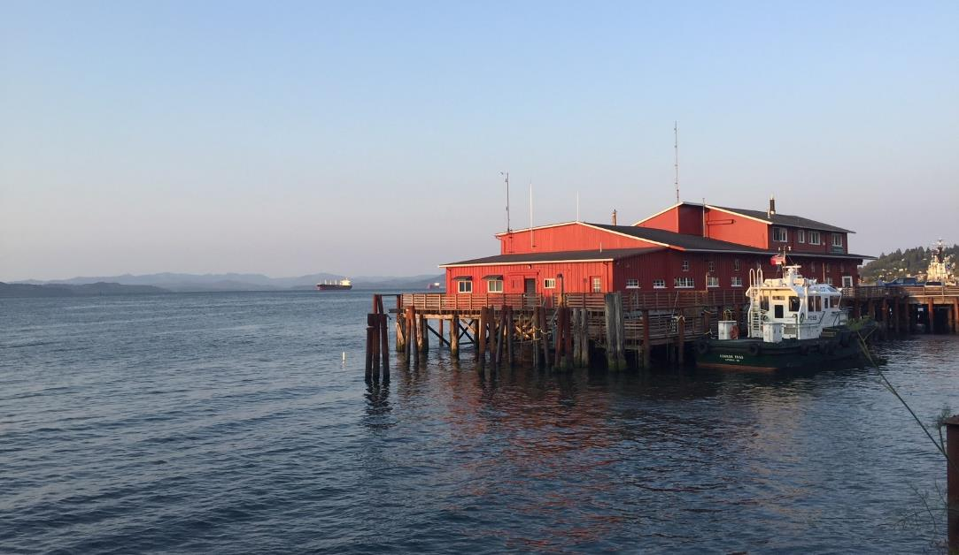
City Council Meeting
March 4, 2019

Slide 2
Meeting Objectives
Provide overview of draft Urban Core code amendments and Planning Commission guidance
Visual & physical access to the river (overwater)
View-related development standards (on-land)
Permitted uses and related development standards
Design standards and guidelines
Landscaping standards
Public comments and discussion
Notes:
2

Slide 3
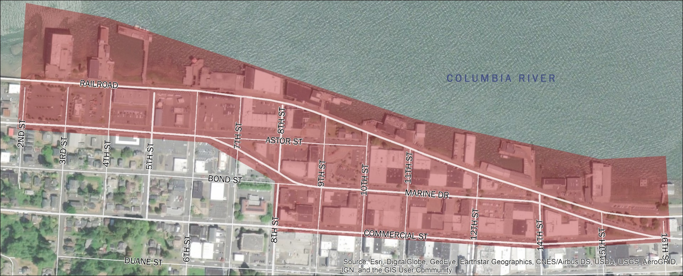
Urban Core Area
Notes:
3

Slide 4
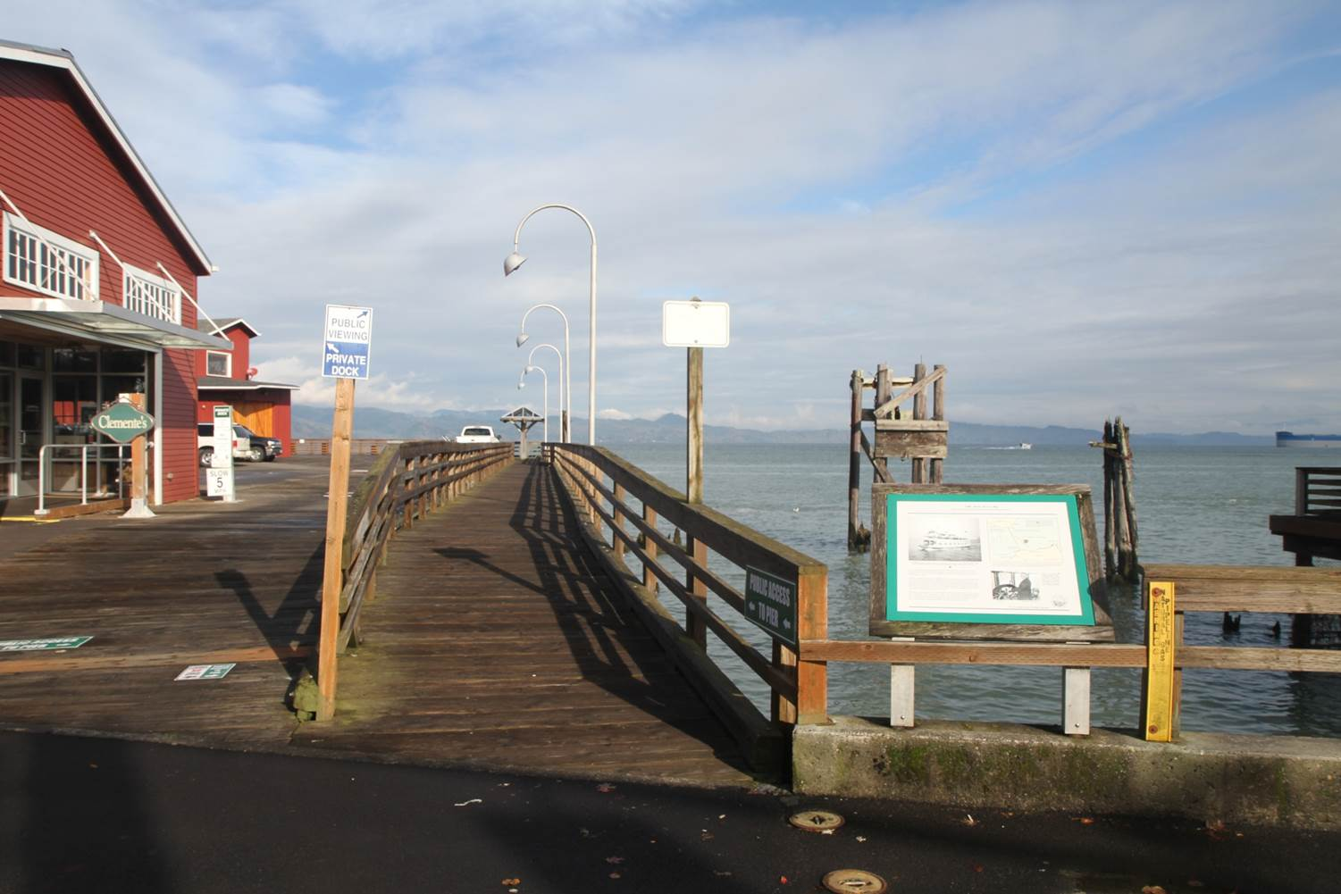
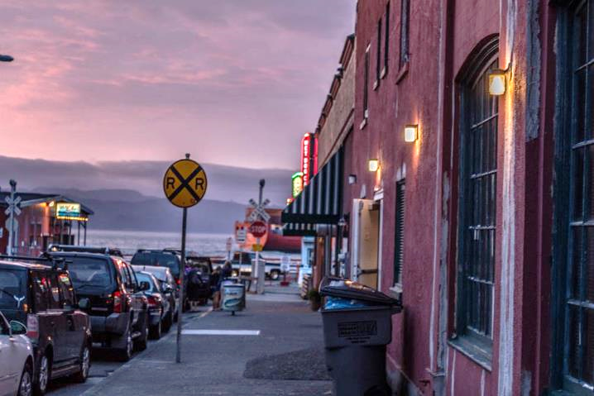
Draft Amendments #1
Visual and Physical Access to the River (Overwater),
View-related development standards
(On-land)
Notes:
4

Slide 5
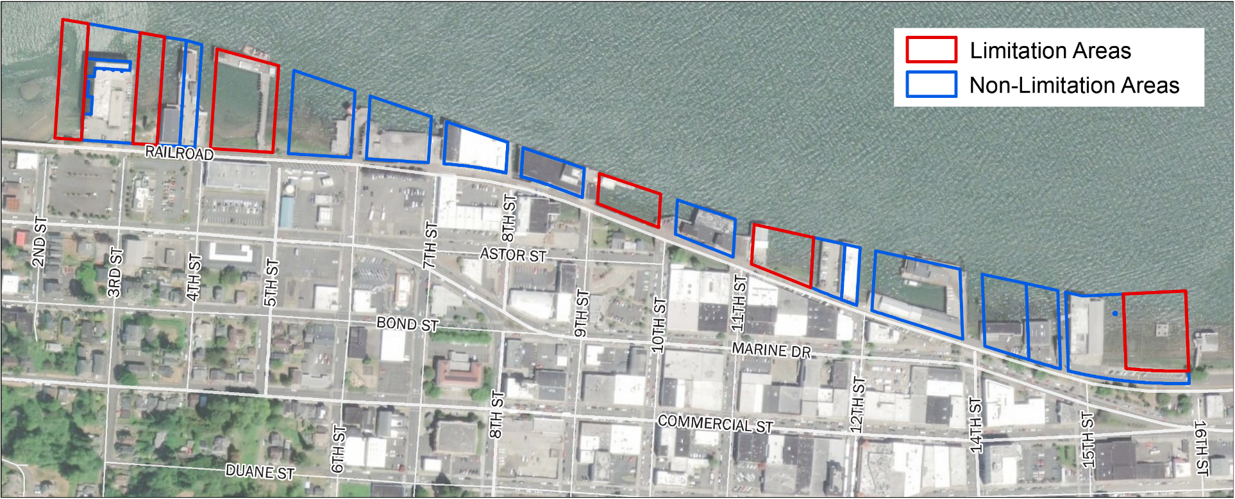
Visual Access to the River (Overwater)
Designate undeveloped sites as “Limitation Areas”
Sites with existing development are “Non-Limitation Areas”
Notes:
5

Slide 6
Visual Access to the River (Overwater)
Standards for Limitation Areas:
Max. Height | Top of adjacent riverbank
Structure Width | Individual building: 60% of parcel width or 150 ft, whichever is less All buildings on contiguous parcels under same ownership: 60% of combined parcel width
Building Spacing | Minimum 40-ft view corridor separation between buildings
Setbacks | Minimum 70-ft view corridor for extended north-south rights-of-way
Structure Size | 4,000 sq ft max. gross floor area
Notes:
6

Slide 7
Visual Access to the River (Overwater)
Standards for Non-Limitation Areas:
Max. height is 28 feet
Up to 35 feet allowed if building width reduced below 60% of parcel width
Same standards for building spacing, setbacks, and structure size as Limitation Areas
Notes:
7

Slide 8
Visual Access to the River (Overwater)
APC Guidance:
Majority support Limitation Areas concept and proposed standards
Some support allowing somewhat taller buildings in exchange for further restricting building width
Notes:
8

Slide 9
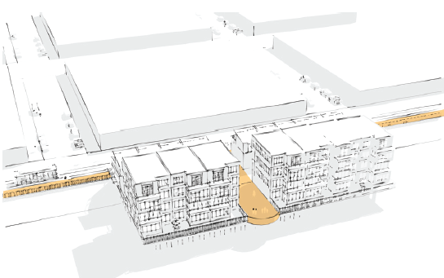
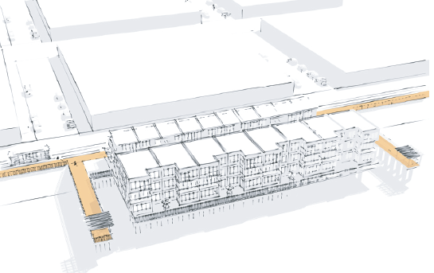
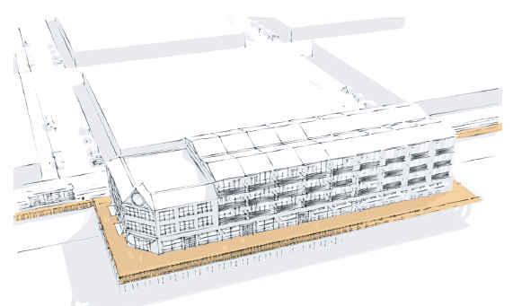
Physical Access to the River (Overwater)
Apply same physical access standards as adopted for Bridge Vista and Civic Greenway areas
Three Access Design Options:
Mid-site access
Viewpoints
River Trail Extension
Notes:
9

Slide 10
Physical Access to the River (Overwater)
APC Guidance:
Majority of APC supported proposed standards for piers or walkways next to, through, or around new overwater buildings
Extensive discussion at last meeting. One Commissioner wanted access via extended rights-of-way to be the only option.
Notes:
10

Slide 11
View-related Standards (On-land)
Building Height
Max. height within 100 ft of River Trail: 28 feet
Max. height in other on-land areas: 35 feet
Allow additional height (up to 45 feet) if:
Multifamily development includes affordable housing
Buildings provide a plaza, courtyard, or other pedestrian amenity or public gathering space
Notes:
11

Slide 12
View-related Standards (On-land)
Setbacks
Setback along north-south rights-of-way: 70-foot minimum view corridor width
Minimum setback adjacent to River Trail:
10 feet on south side; 20 feet on north side
Setback area must be landscaped or include pedestrian-oriented amenities
Notes:
12

Slide 13
View-related Standards (On-land)
Stepbacks
Stepbacks required along both the River Trail and street frontages
Stepback above 15 feet or 1 story, whichever is less
Minimum stepback depth of 10 feet
Balconies and fixed awnings shall not encroach into the stepback area
Notes:
13

Slide 14
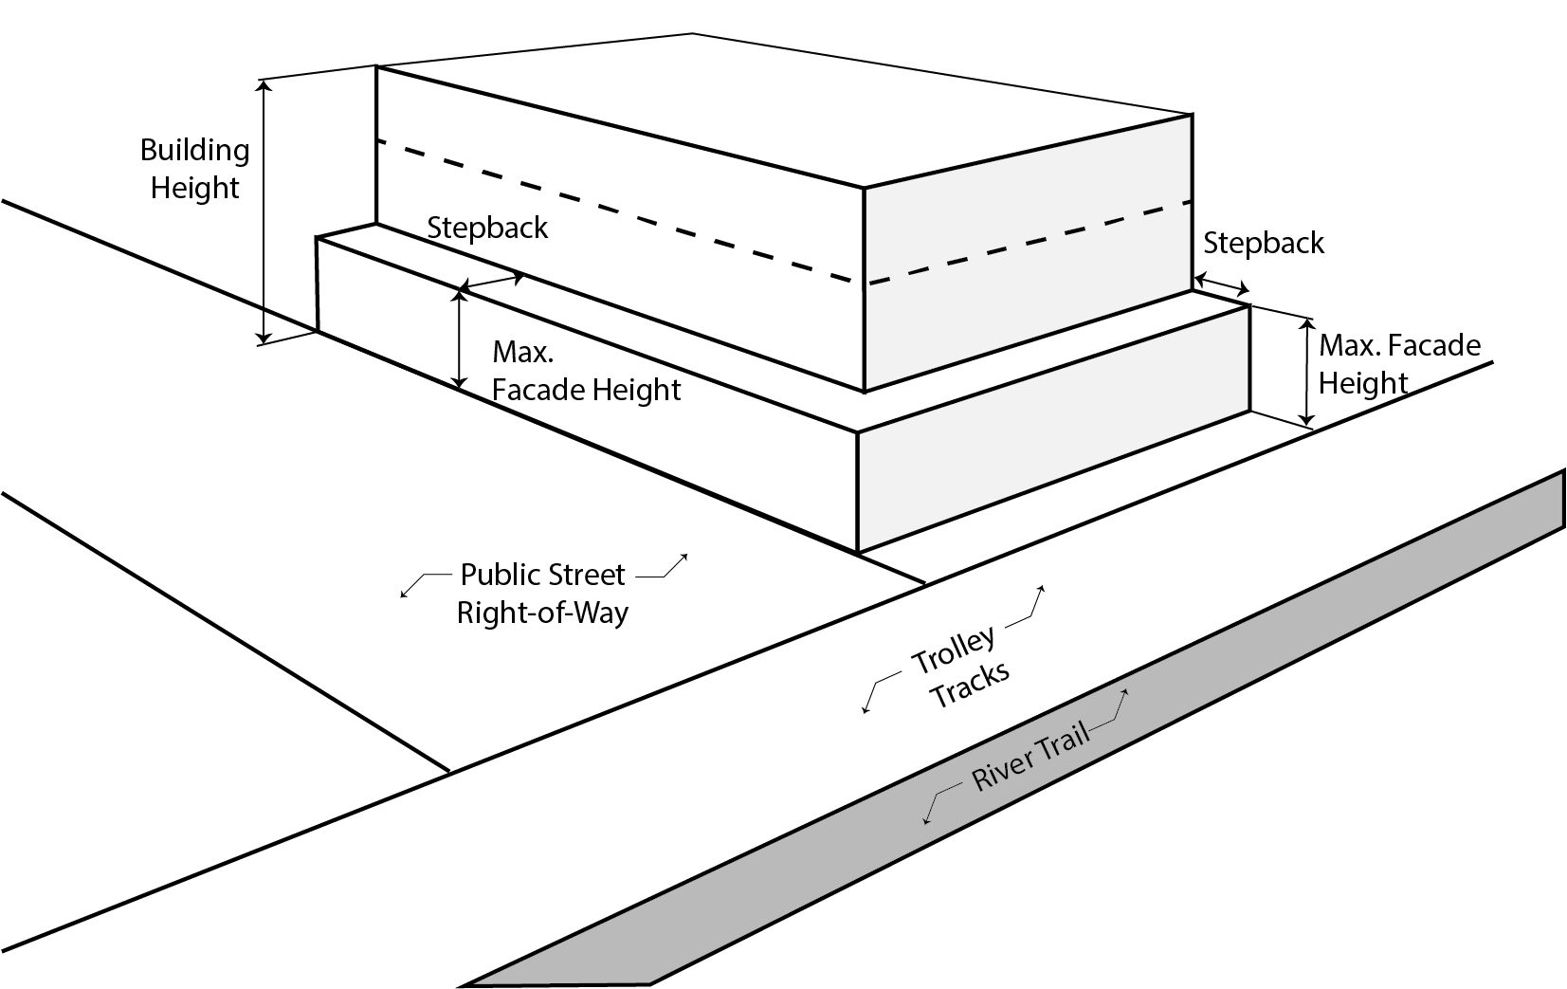
View-related Standards (On-land)
Stepbacks
Notes:
14

Slide 15
View-related Standards (On-land)
APC Guidance:
Building Height:
Recommendation to reduce building height to 35 feet (from 45 feet allowed in base zones) was per APC suggestion.
Also suggested allowing additional height for affordable housing or pedestrian amenities.
Setbacks: APC supported recommendation
Stepbacks: APC mostly supported recommendation (although some did not support requiring stepbacks along north/south streets)
Notes:
15

Slide 16
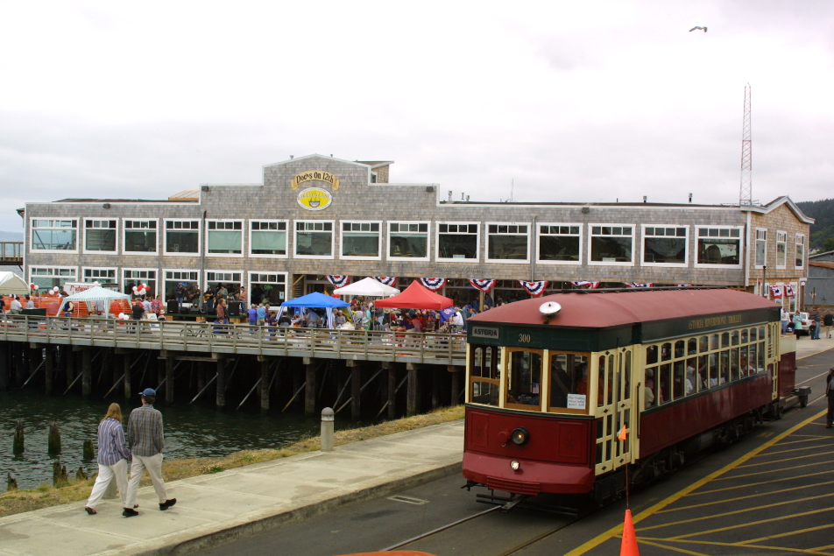
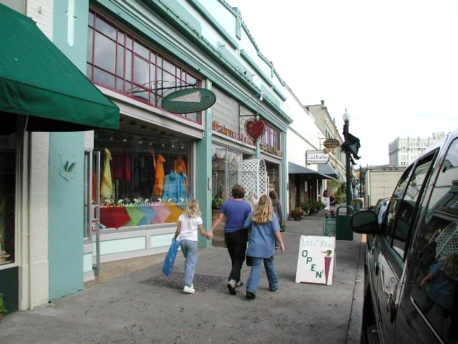
Draft Amendments #1B
Rezoning and Use Regulations
Notes:
16

Slide 17
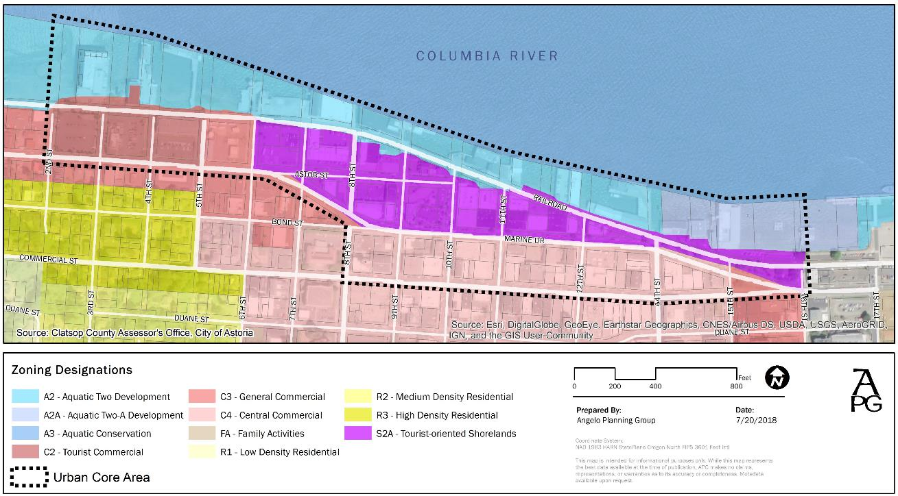
Current Zoning
A-2
C-2
C-3
S-2A
A-2A
C-4
Notes:
17

Slide 18
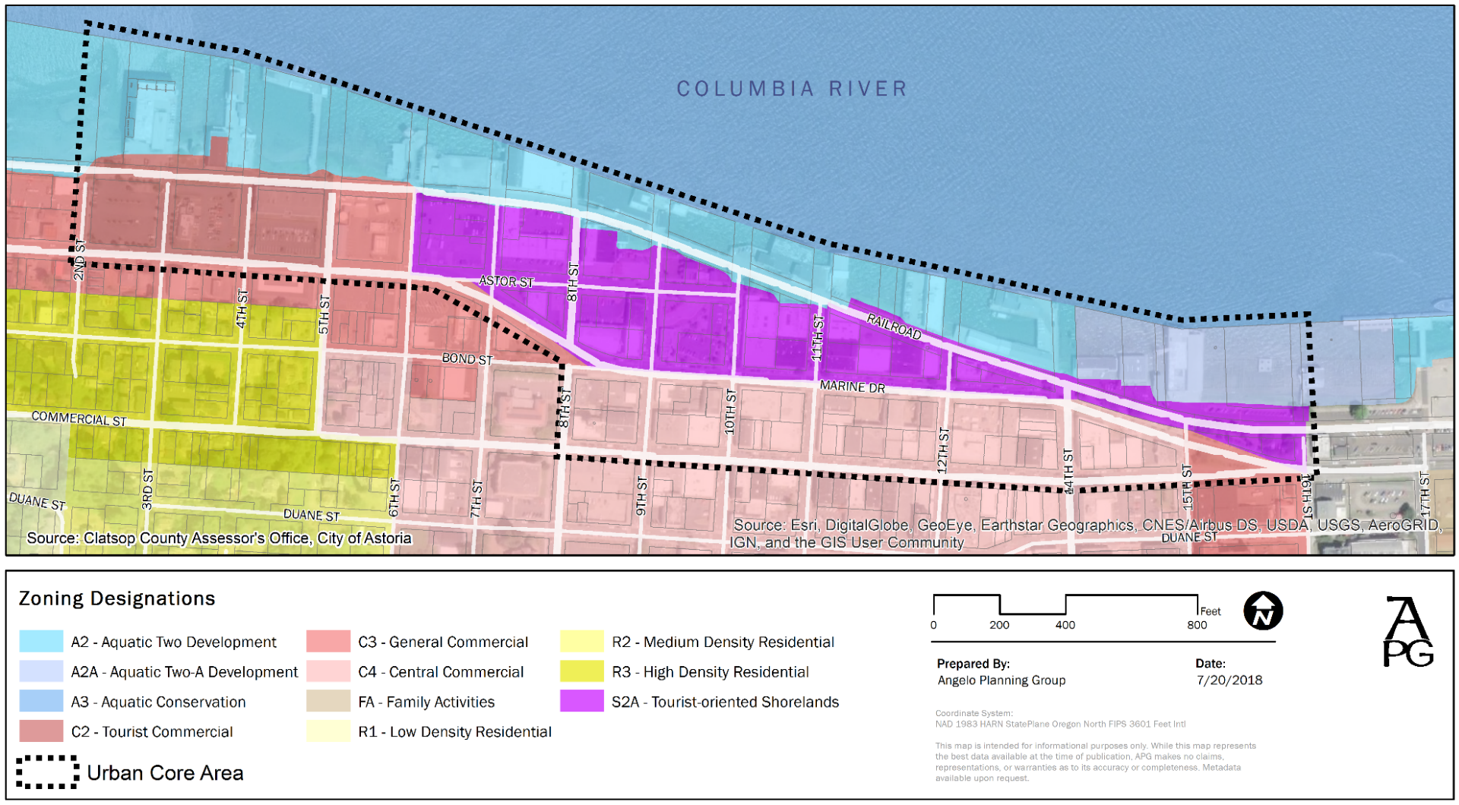
Recommended Rezoning
S-2A to C-3
C-2 to C-3
S-2A to C-3
S-2A to C-4
C-3 to C-4
Notes:
18

Slide 19
Overwater Uses
Prohibit in Aquatic Zones:
Indoor entertainment (except indoor family entertainment).
Hotels/motels (but allow facilities existing prior to adoption of the code to be repaired, replaced, and/or redeveloped with new hotels/motels).
Conference center.
Fossil fuel and petroleum product terminals.
Auto sales and gas stations.
Wood processing.
Professional, medical offices.
Residences (except residences existing prior to adoption of the code to be repaired, replaced, and/or redeveloped with new residences)
Other uses: defer to base zones
Notes:
19

Slide 20
On-land Uses
Permit Outright in Commercial Zones:
Manufacturing or light manufacturing with a retail component.
Multi-family dwellings above ground-floor commercial.
Existing motels/hotels and their expansion and reconstruction if destroyed.
Park and museum.
Shoreline stabilization.
Small boat building and repair.
Navigation aide.
Transportation service establishment.
Permit as Conditional Uses:
Motel/hotel when parking is located at the rear or interior of the site, screened by the building
Notes:
20

Slide 21
On-land Uses
Prohibit in Commercial Zones:
Development Standards (On-land)
Establish maximum gross floor area of 30,000 square feet for commercial uses
Auto sales and services.
Gasoline services stations.
Manufacturing or light manufacturing without a retail component.
Single-family or two-family dwelling, except above, below or in the rear of first-floor commercial.
Animal hospital or kennel.
Conference center.
Construction service establishment.
Drive-through facilities.
Hospital.
Repair service establishment not allowed as an Outright Use.
Transportation service establishment.
Wholesale trade or warehouse establishment.
Notes:
Warehouse in some areas close to the use?
Light manuf w/ retail – how much?
21

Slide 22
Rezoning and Use Regulations
APC Guidance:
General support for recommendations.
Recommendation to prohibit residential uses overwater (except rehabs of existing residential) was per APC suggestion.
Mixed opinions on permitting medical and dental offices overwater (recommended to be prohibited).
Added permitted uses for Commercial Zones per APC suggestion so as not to lose uses permitted in S-2A zone.
Notes:
22

Slide 23
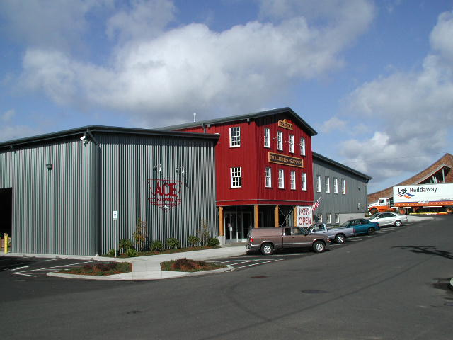
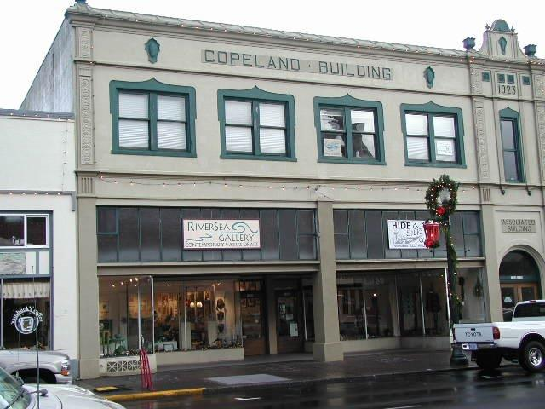
Draft Amendments #1C
Design Standards & Guidelines,
Landscape Standards
Notes:
23

Slide 24
Building Style and Form
Proposed new standards/guidelines: (these are typical of downtown design standards/guidelines in other cities)
Facade Variation (recess, extension, roofline offset, or similar feature) every 30 feet
Prominent main entry oriented to the sidewalk; design features to distinguish main entry
Distinctive base, middle, and top of building
Parking location to side or rear of buildings
Compatibility with nearby historic buildings
Corner entries or accentuated corners encouraged
Architectural bays encouraged to reflect traditional storefront design
Notes:
24

Slide 25
Other Design Standards & Guidelines
Largely adapt standards from Bridge Vista Overlay Zone:
Roof Forms & Materials
Doors
Windows
Siding & Wall Treatments
Awnings
Lighting
Signs
Notes:
25

Slide 26
Design Standards & Guidelines
APC Guidance:
Supported concepts for new Building Style and Form standards/guidelines, but haven’t reviewed specifics yet.
Generally supported other standards and guidelines. Suggested some changes.
Notes:
26

Slide 27
Setbacks
Adjacent to Marine Drive and parallel rights-of-way (except River Trail):
Minimum setback: 0 feet
Maximum setback: 5 feet
Max. setback may be extended to 20 feet for up to 50%of building facade if used for a walkway, plaza, courtyard, or other pedestrian-oriented amenity or public gathering space
APC Guidance: Supported recommendations
Notes:
27

Slide 28
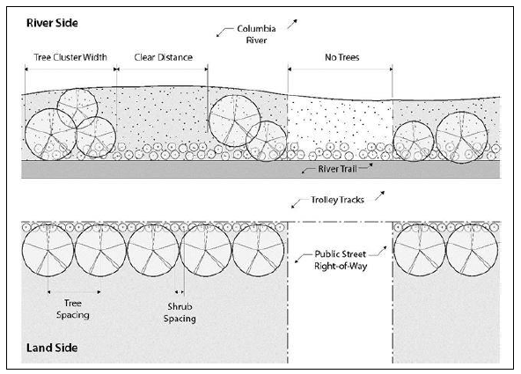
Landscaping
Adapt standards from the Bridge Vista and Civic Greenway Overlay Zones
Notes:
28

Slide 29
Landscaping
APC Guidance:
General support for recommendations
Suggested clarification for riparian areas south of River Trail
Notes:
29

Slide 30
Next Steps and Schedule
Draft #2 of Amendments – coordinate with pending Bridge Vista Overlay amendments
APC Public Hearing, May 28, 2019 (tentative)
Draft #3 of Amendments
City Council Public Hearing, July 1, 2019 (tentative)
Notes:
30

